Slide 1

Wellfield Health and Water Production Summary
September 22, 2025

Slide 2
Below 80% sequenced normally
88% Impaired
90% and higher taken out of sequence to protect well

Slide 3
Summary of Wellfield Condition
Sand Springs wells have improved slightly due to reduced usage and rainfall of more than 3 inches.
River Alluvium wells have a good water level; however, the chemistry makes their use limited.
Action items:
- Further reduction in customer usage
- Continue monitoring drawdowns
- Identify and secure additional water source
Action Items

Slide 4
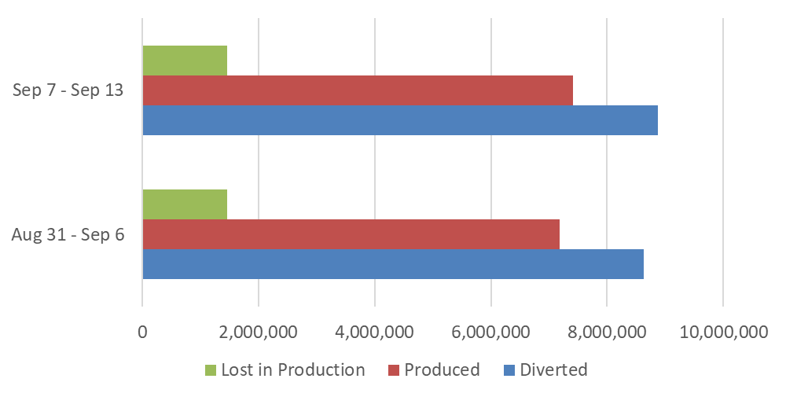
Water Diverted, Produced, and Lost in Production
Aug 31 – Sep 6, 2025
Diverted: 8,634,000
Produced: 7,177,790
Lost During Production: 1,456,210
Percentage Loss: 17%
Sep 7 – Sep 13, 2025
Diverted: 8,874,000
Produced: 7,410,860
Lost During Production: 1,463,140
Percentage Loss: 16%

